Slide 1
Artificial Intelligence for Games Week 4 – Pathfinding 1 Steve Rabin
For help on projects, email everyone (select and copy this string from the start of any class PowerPoint):
steve.rabin@gmail.com, p.jiankai@digipen.edu, b.hsu@digipen.edu, zak.s@digipen.edu, keaton.sullivan@digipen.edu, john.tseng@digipen.edu, a.roulst@digipen.edu
TAs: Jian Kai Phua, Brandon Hsu, Zak Stephenson, Keaton Sullivan, John Tseng, Andrew Roulst

Slide 2

Questions
Flocking: What are the individual agents called?
Flocking: Name the 3 primary steering behaviors.
Flocking: Name the other 3 helpful steering behaviors.
Flocking: How is the leader chosen?
What is this cellular automata configuration called?

Slide 3
Questions
Flocking: What are the individual agents called?
Flocking: Name the 3 primary steering behaviors.
Flocking: Name the other 3 helpful steering behaviors.
Flocking: How is the leader chosen?
What is this cellular automata configuration called?
Cellular automata is Turing Complete. What does that mean?
Formations: Describe the 2 levels of steering.

Slide 4
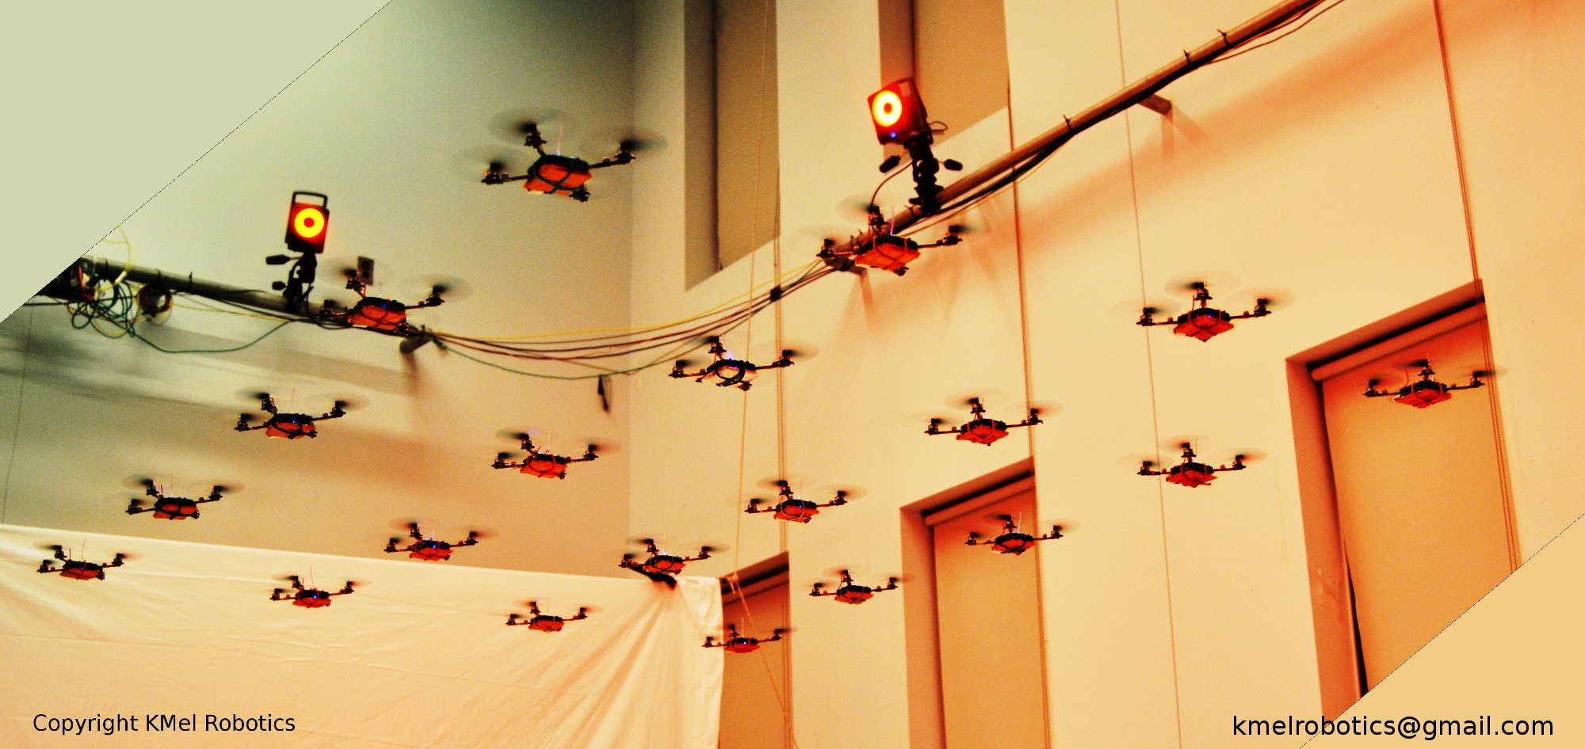
Swarm of Nano Quadcopters
http://www.youtube.com/watch?v=YQIMGV5vtd4

Slide 5
News Flash!!!
“Cars may one day mimic fish to avoid collisions”
Dateline: Thu Oct 1, 6:06 AM
http://ca.news.yahoo.com/s/afp/091001/oddities/japan_auto_technology_offbeat

Slide 6

“Cars may one day mimic fish to avoid collisions”
TOKYO (AFP) - Engineers in Japan say they are a step closer to developing technology they hope will cut the risk of car crashes -- by mimicking the behavior of fish.
The experts at Nissan Motor have been studying fish and the way they are able to swim in schools and avoid colliding with each other.

Slide 7
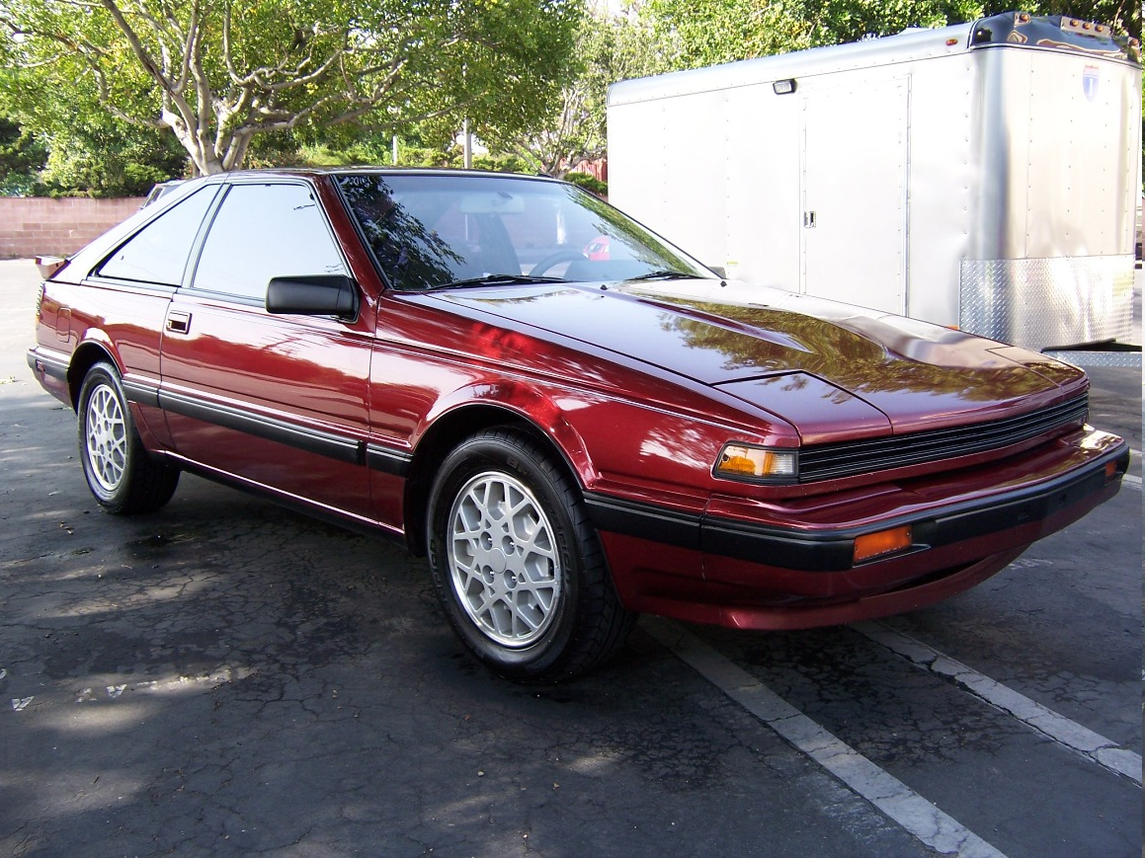
Nissan: Welcome back to 1987!!!

Slide 8
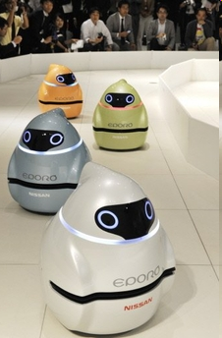
“Cars may one day mimic fish to avoid collisions”
The result is a robot that can travel in a group of up to seven, avoiding bumps by sharing information with its peers.
The firm hopes to use the technology in its vehicles in future.
The three-wheeled robot uses a laser range finder, which measures the distance to an obstacle, and radio communications to recreate the behavior of fish, which can change direction and travel side by side without colliding.

Slide 9
“Cars may one day mimic fish to avoid collisions”
Last year Nissan unveiled a similar robot inspired by the bumblebee, which is also highly adept at avoiding collisions but travels solo.
“We, in a motorized world, have a lot to learn from the behavior of a school of fish in terms of each fish’s degree of freedom and safety,” said Toshiyuki Andou, the principal engineer in the project.
By sharing information, the group can travel safely, changing its shape as needed, Andou said.
Nissan will demonstrate the technology at the CEATEC electronics trade fair in Japan next week.

Slide 10
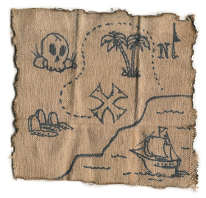
Movement
Reactive
Planned

Slide 11
Planned Movement
Define a search space representation
Apply a search algorithm to find a path
Post-process path
Agent follows path

Slide 12
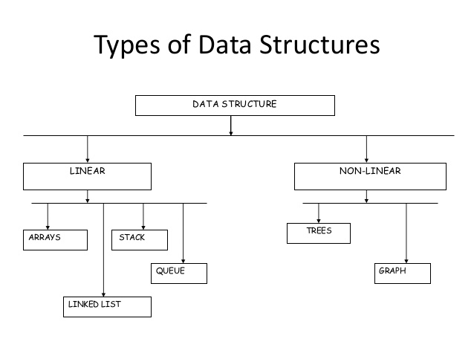
Search Space Representations

Slide 13
Search Space Representations
Types of Graphs?
Types of Trees?

Slide 14
Search Space Representations
Grids
Quadtree / Octree
Waypoint graphs
Corner graphs
Circle-based waypoint graphs
Navigation meshes

Slide 15
Important Questions to Ask
How well does the search space scale?
Larger search space = slower search
Who makes the search space?
Level Designer or Algorithm?
Does the search space represent
Safe paths?
Safe walkable areas?
2D or 3D?

Slide 16
Grids

Slide 17
Grids

Slide 18
Grids

Slide 19
Quadtrees

Slide 20
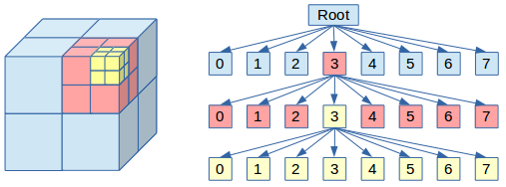
Octrees

Slide 21
Waypoint Graphs

Slide 22
Waypoint Graphs

Slide 23
Corner Graphs (Points of Visibility)

Slide 24
Corner Graphs (Points of Visibility)

Slide 25
Corner Graphs (Points of Visibility)

Slide 26
Circle-Based Waypoint Graph

Slide 27
Navigation Meshes (Nav Mesh)

Slide 28
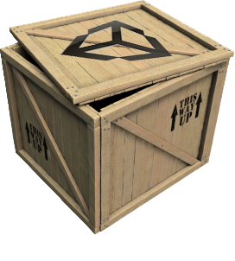
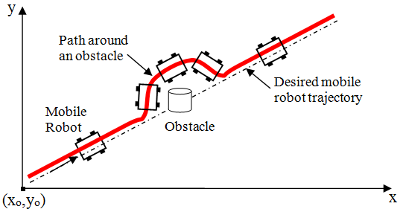
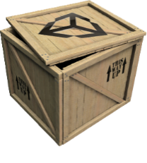
Local Obstacle Avoidance

Slide 29
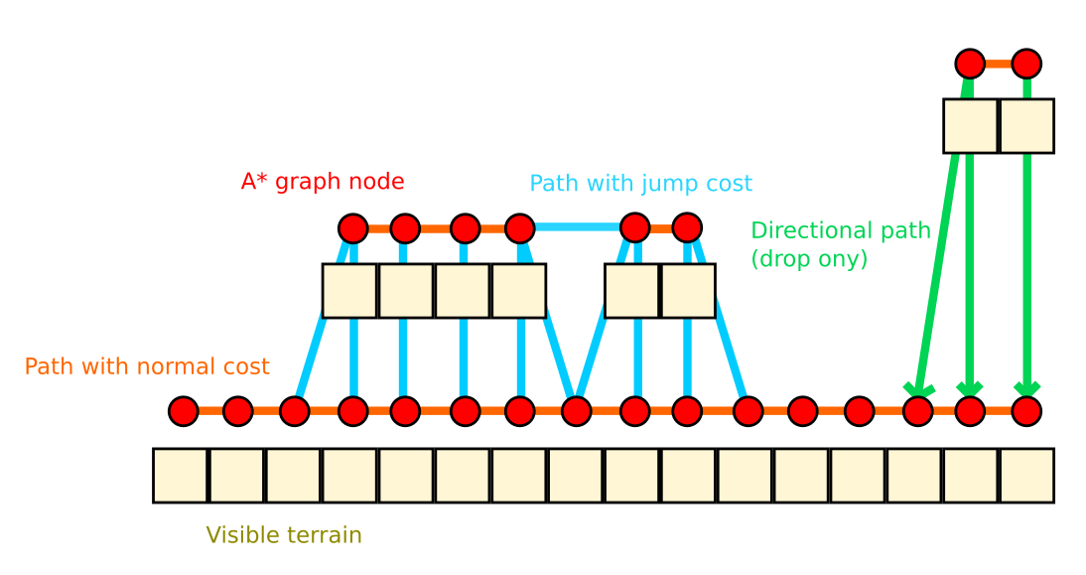
Ledges and Jumps

Slide 30
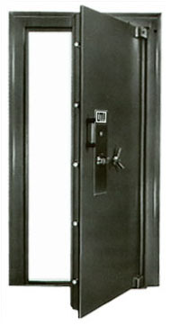
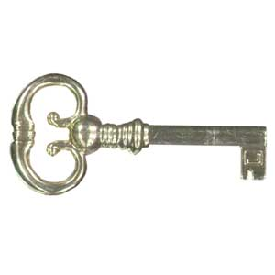
Doors, Elevators, etc.
Smart pathfinding nodes
Annotated with required action

Slide 31
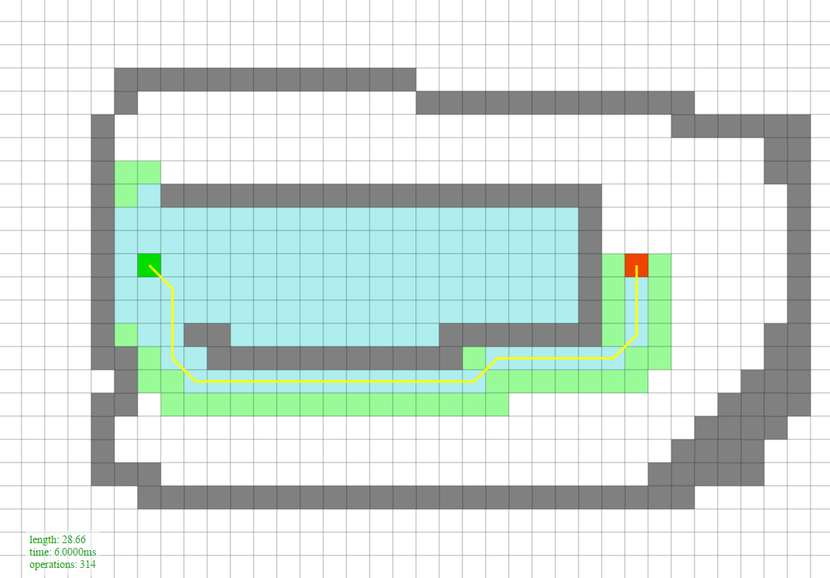
Search

Slide 32
Judging Search Algorithms
Quality of path
Shortest?
Optimal, near-optimal, or a reasonable path
Resource requirements
CPU, memory
Completeness
Will find a path if one exists

Slide 33
Pathfinding Search Algorithms
Random Bounce
Robust Trace
Breadth-First
Depth-First
Dijkstra
Greedy Best-First
A*
Jump Point Search (JPS+)
Roy-Floyd-Warshall

Slide 34
Open and Closed Lists
Open List
Promising nodes not yet explored
Closed List
Nodes already explored

Slide 35
Grid Search Space: Node Structure
Node* parent; // Parent (in general)
float cost; // Cost

Slide 36
Search Algorithm Structure
1. Push Start Node onto the Open List
2. While (Open List not empty)
a. Pop a node from the Open List (parent node)
b. If node is Goal Node, then return path
c. Find neighboring child nodes and score them
d. Conditionally add them to the Open List
e. Place parent node on the Closed List

Slide 37
PathDemo

Slide 38
A*
Combines Dijkstra and Greedy Best-First
Given cost and Heuristic cost
Open List sorted by:
Final cost = Given cost + Heuristic cost
f(x) = g(x) + h(x)
Final cost = Given cost + (Heuristic cost * weight)
f(x) = g(x) + (h(x) * weight)

Slide 39
A*
Completeness
Heuristic Search
Admissible heuristic = Optimal path
Factoid: An admissible heuristic does nothing for Greedy Best First.
This is a challenge. The closer you get to the true cost, the more efficient A* will be. But if you go over, A*will no longer guarantee an optimal path.
Factoid: A heuristic guess of zero is admissible! A* will just become Dijkstra if h(x) = 0.

Slide 40
Recap of Search Algorithms
Guarantee a path is found if it exists (completeness)
Breadth-First, Depth-First, Dijkstra, A* and all variants
Guarantee an optimal path
Dijkstra, A* and all variants (if admissible heuristic)
Heuristic search algorithms (smart, head toward goal)
Greedy Best-First, A* and all variants

Slide 41
Search

Slide 42
A* Algorithm
If (request.newRequest) {
Initialize everything. Clear Open/Closed Lists.
Push Start Node onto the Open List with cost of f(x) = g(x) + h(x).
}
While (Open List is not empty) {
parentNode = Pop cheapest node off Open List.
If parentNode is the Goal Node, then path found (return PathResult::COMPLETE).
Place parentNode on the Closed List.
For (all neighboring child nodes of parentNode) {
Compute its cost, f(x) = g(x) + h(x)
If child node isn’t on Open or Closed list, put it on Open List.
Else if child node is on Open or Closed List, AND this new one is cheaper,
then take the old expensive one off both lists and put this new
cheaper one on the Open List.
}
If taken too much time this frame (or if request.settings.singleStep == true),
abort search for now and resume next frame (return PathResult::PROCESSING).
}
Open List empty, thus no path possible (return PathResult::IMPOSSIBLE).

Slide 43
A* Worksheet

